Slide 1
Covid Tracking
File created on: 8/11/20 12:24:04 AM CDT

Slide 2
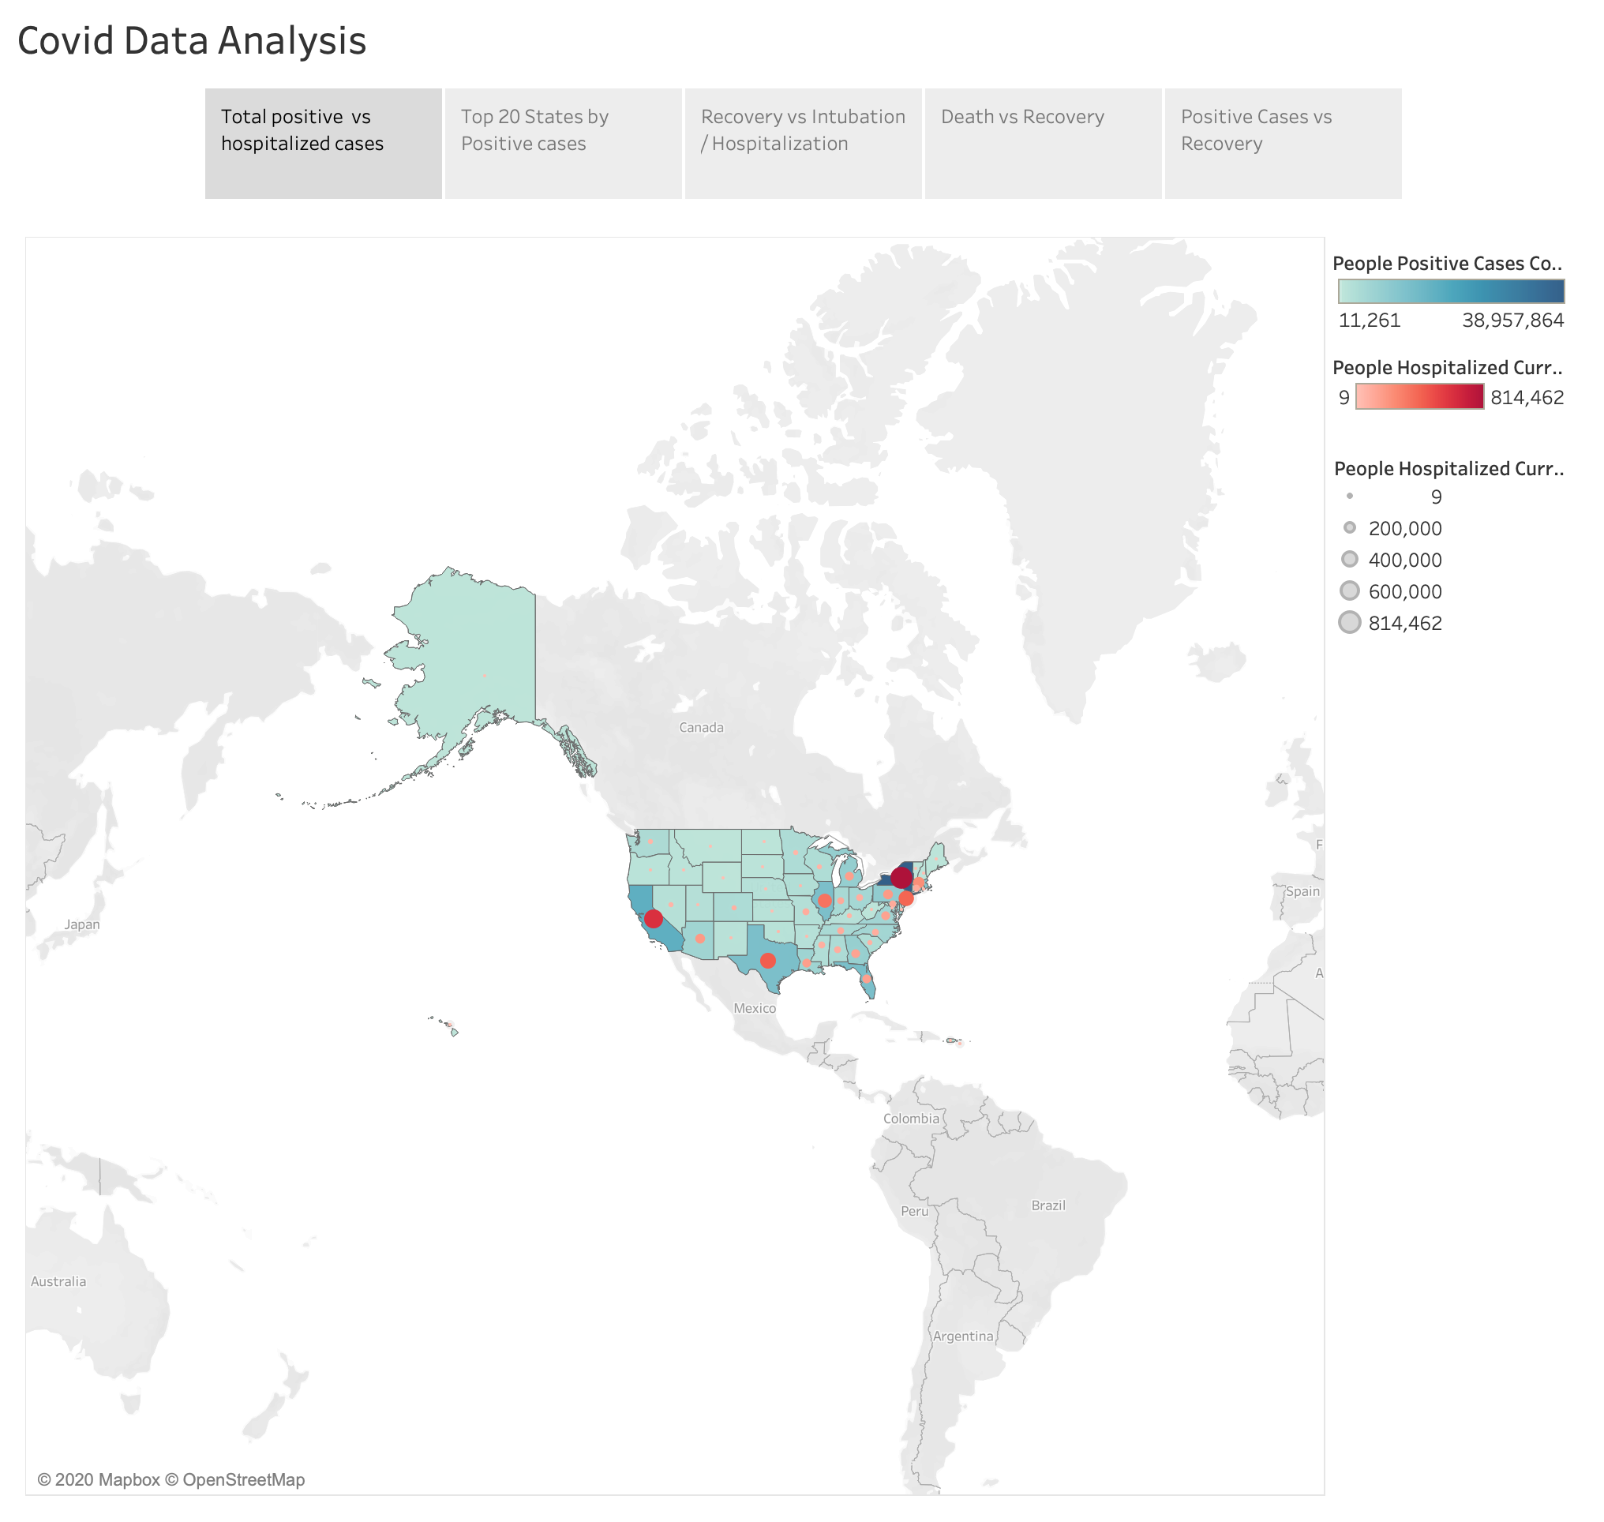

Slide 3
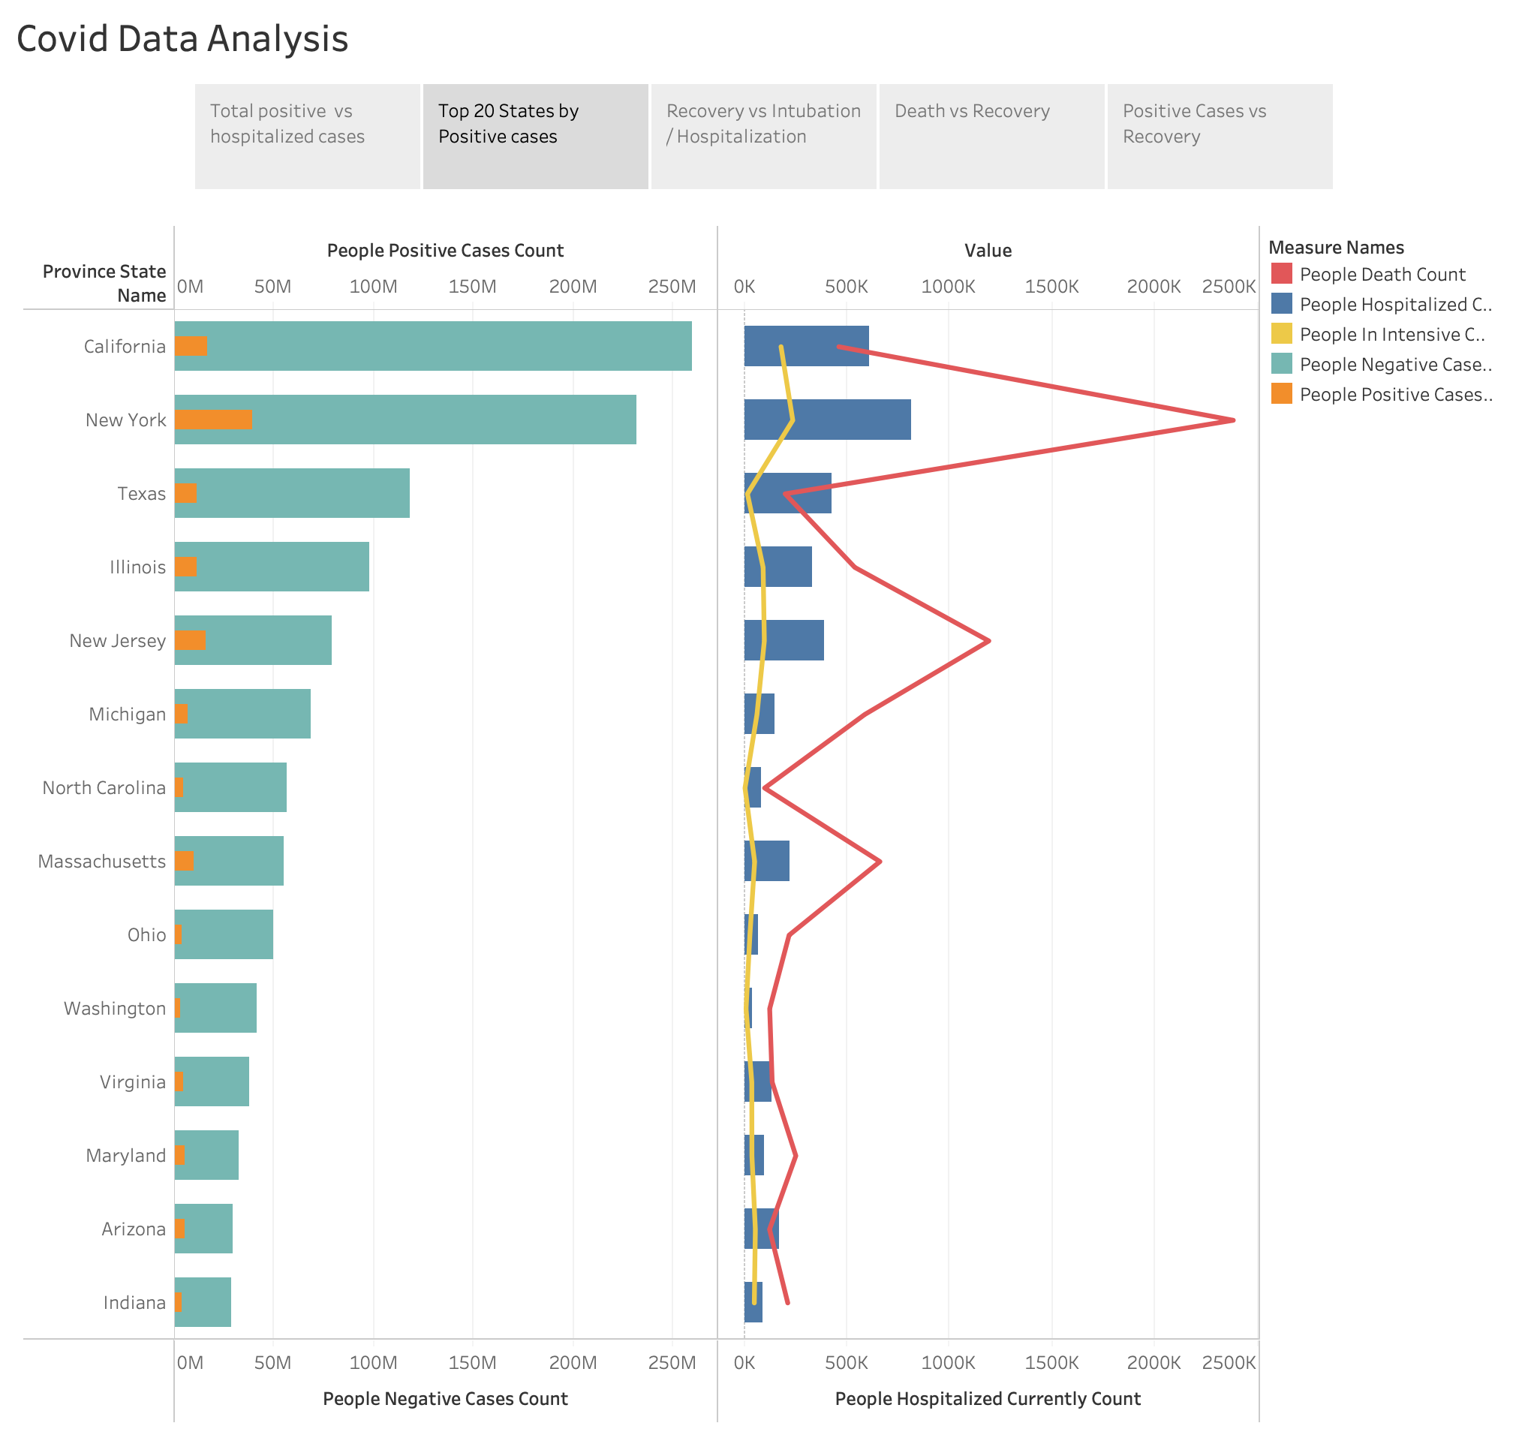

Slide 4
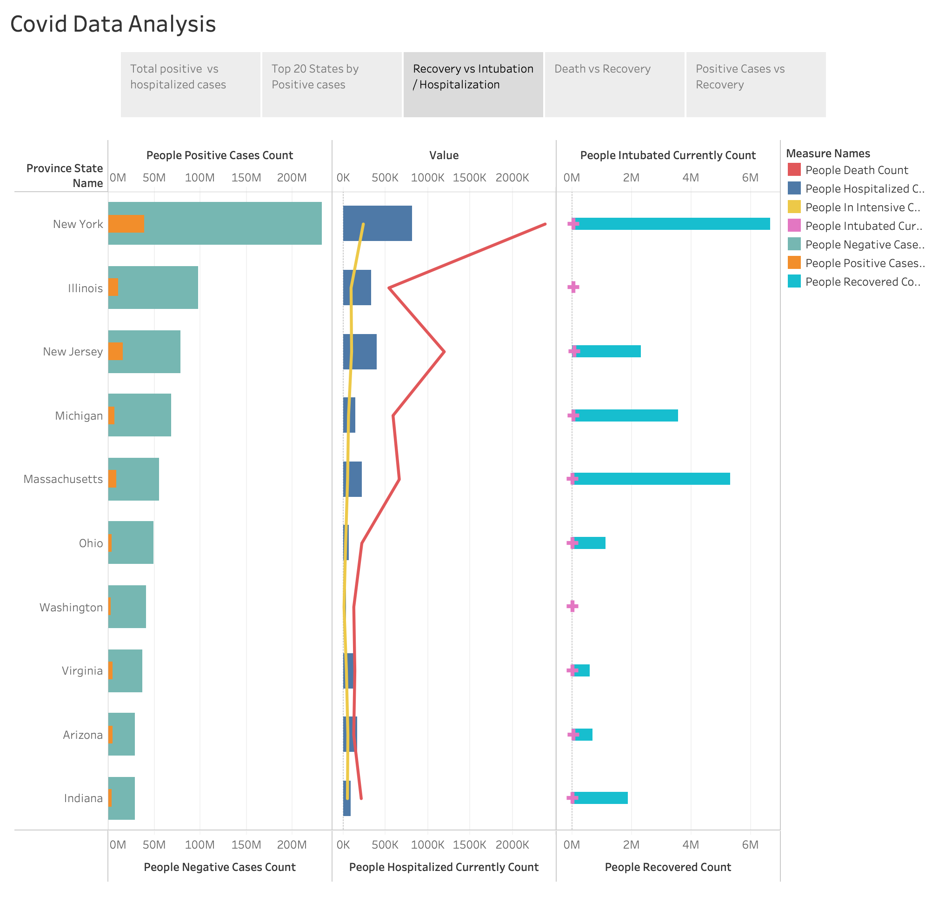

Slide 5
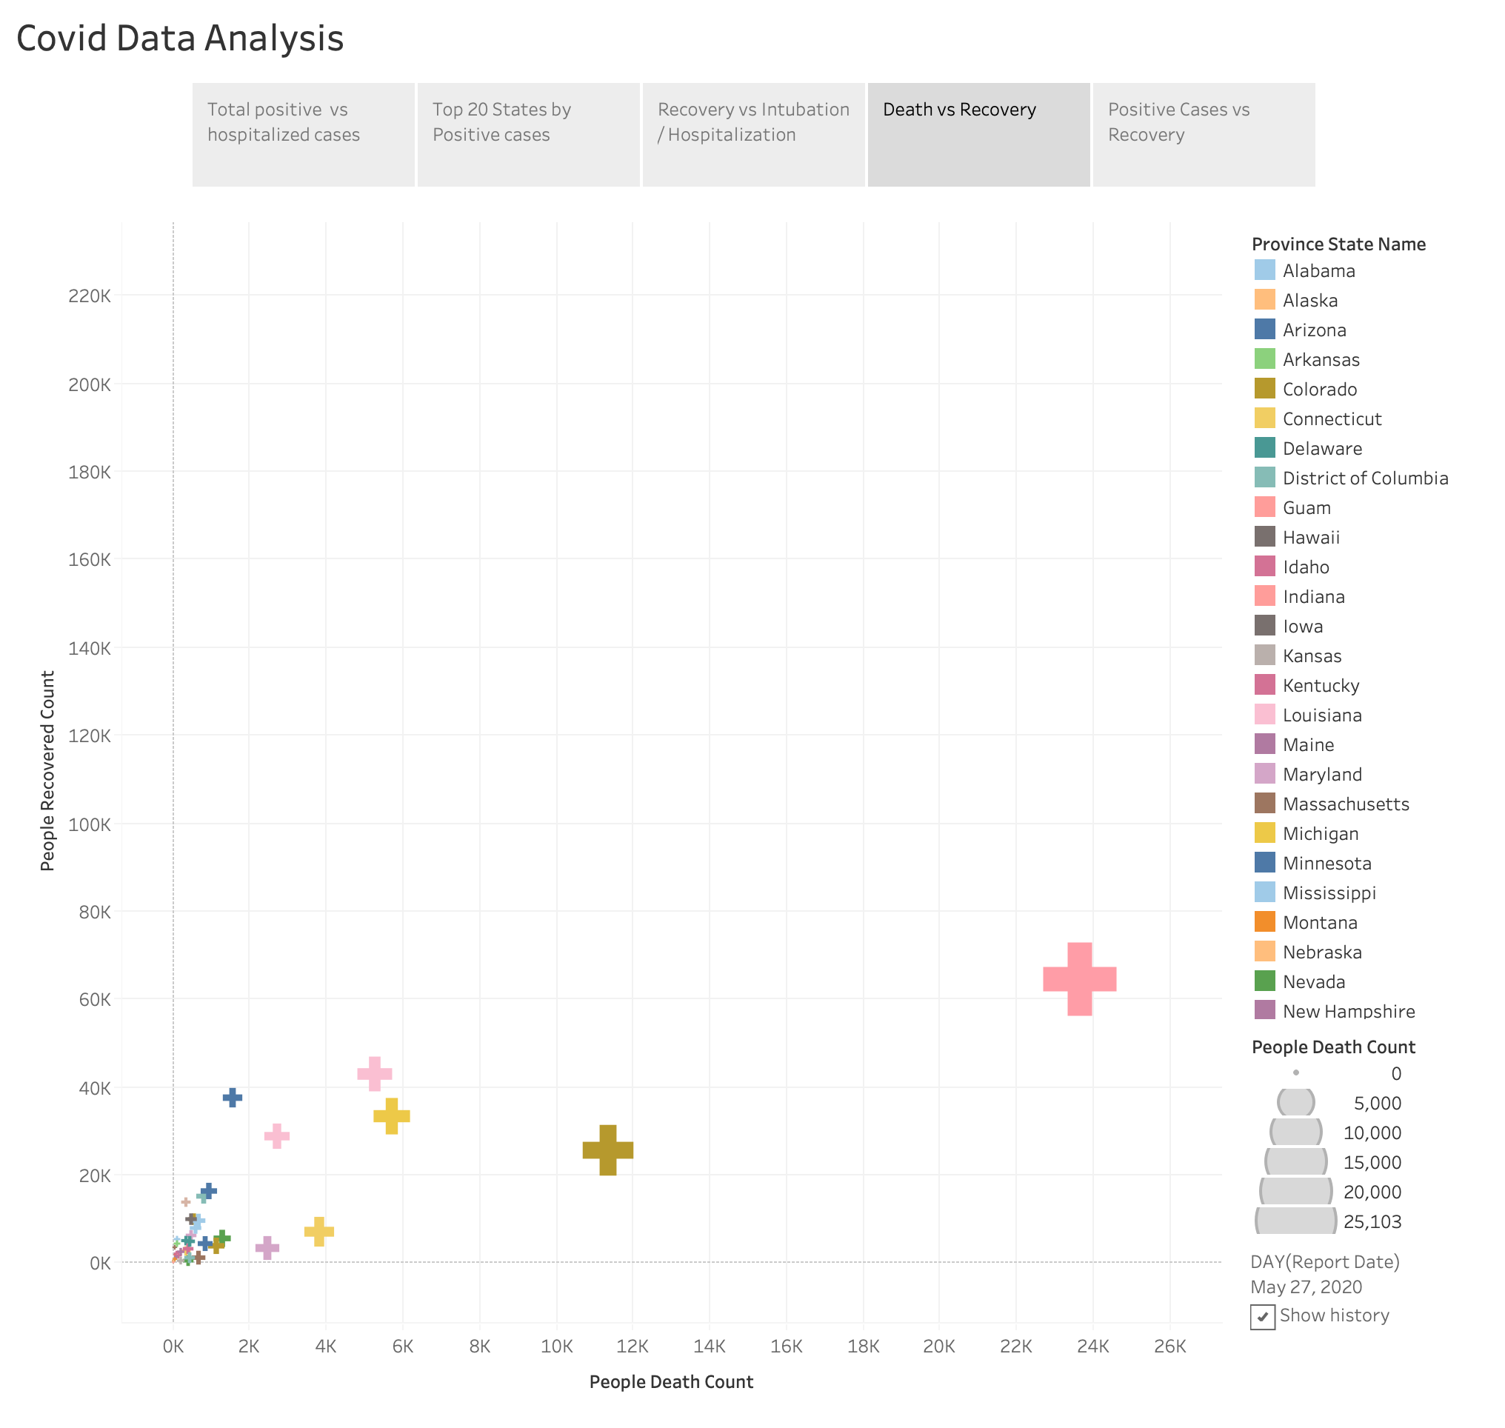

Slide 6
